Slide 1


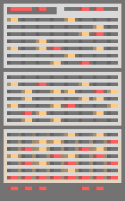



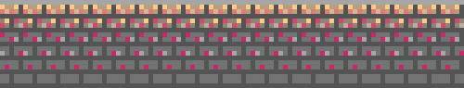
TOWER OF ODYSSEY
LET’S START

Slide 2



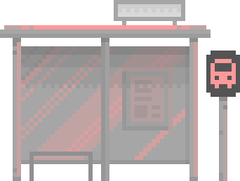
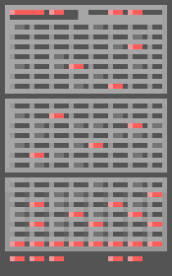
BY
HOMER’S CIRCLE
DUA FATIMA
GULWARINA MUSKA SALEEM
SARA FAWAD
ANEEQA ZAHID

Slide 3
Your pROLES OF TEAM MEMBERSaragraph text
DUA
Create the PowerPoint presentation slides (project idea, features, architecture, third-party modules).- Document the breakdown of work done by each member.
ANEEQA
Prepare and conduct the project demo (test all features to ensure they run smoothly during the demo).- Screen Record the demo.Test everything (internet connection, audio, video, demo functionality).
GULWARINA
Document the final project architecture in detail.- Provide descriptions of modules, third-party libraries, and interactions.- Create necessary diagrams.
SARA
- Set up and finalize the GitHub repository.- Write the README.md file with project title, members, description, features, architecture, and running instructions.-

Slide 4


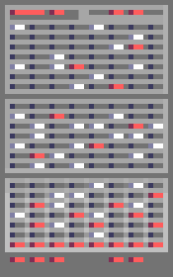
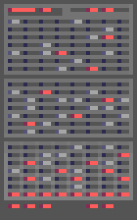

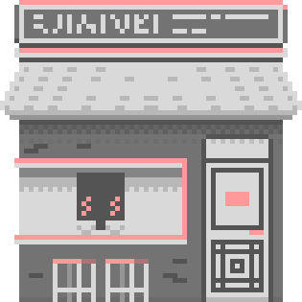


AREYOU READY?

Slide 5


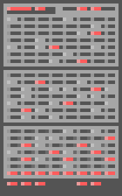
INTRODUCTION:
·Overview:
Tower of Odyssey is an interactive, console-based game designed to teach and reinforce C++ programming concepts in a fun and engaging way.
·Purpose:
To combine learning with entertainment, helping users strengthen their coding skills through problem-solving and challenges.

Slide 6
OBJECTIVES
·Teach core C++ programming concepts (e.g., syntax, variables, functions).
·Provide an engaging gaming experience with mazes, puzzles, and challenges.
·Encourage critical thinking and debugging skills.

Slide 7


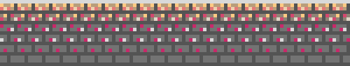
STORYLINE:
·Plot:
You are a novice coder trapped in a mysterious building. To escape, you must ascend seven floors, solving C++ programming challenges and collecting parts.

Slide 8
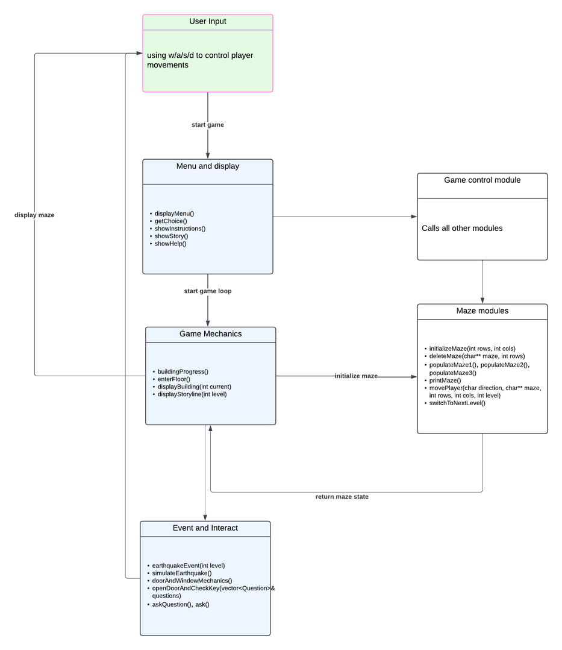


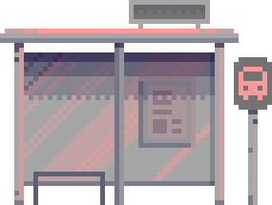
PROGRAM ARCHITECTURE

Slide 9
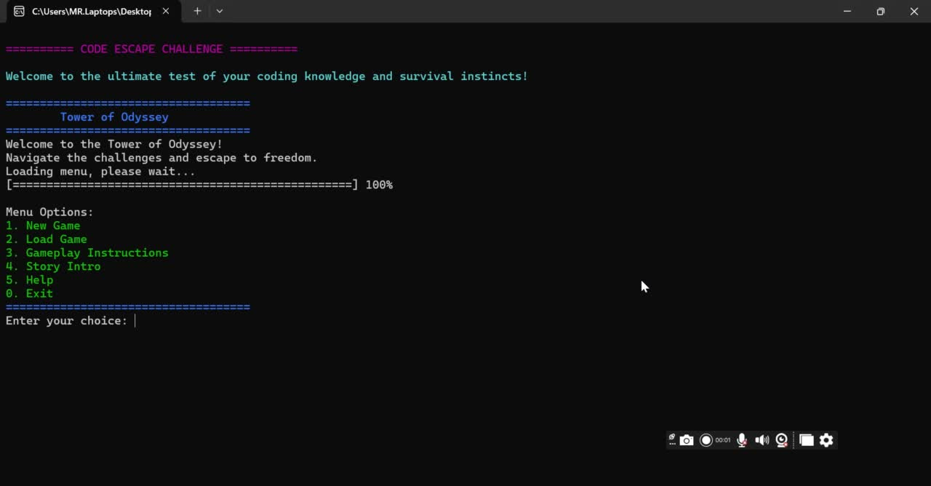

Slide 10
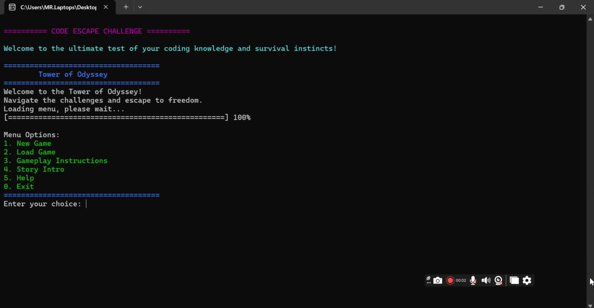

Slide 11




FEATURES:
·7 Levels (Floors):
Each level focuses on a specific C++ concept:
1.Basics (variables, operators) & syntax
2.Functions and loops
3. Arrays

Slide 12

FEATURES:
·Interactive Gameplay:
1.WASD-based navigation in dynamic mazes.
2.Doors hiding C++ questions.
3.Windows as obstacles deducting points.
·Random Events:
1.Burglar challenges.
2.Earthquake debugging.
Save and Load System: Automatic progress tracking.

Slide 13




GAMEPLAY FLOW:
·Start:
·Enter the building via the main menu.
·Navigate through a grid-based maze.
·Challenges:
·Solve C++ questions to open doors.
·Avoid window collisions.
·Progression:
·Find the hidden key on each floor.
·Ascend to the next floor and increase difficulty.
·Winning:
Escape the building by solving all puzzles

Slide 14
TECHNICAL IMPLEMENTATION:
·Programming Language:
C++
·Libraries Used:
Strings and character data
Math and numerics
Sequence containers
Algorithms
Time

Slide 15
TECHNICAL IMPLEMENTATION:
·Programming Language:
C++
·Libraries Used:
Strings and character data
Math and numerics
Sequence containers
Algorithms
Time

Slide 16
CHALLANGES WE FACED:
·Designing dynamic mazes with valid paths to doors and keys.
·Implementing real-time interactions using WASD controls.
·Randomizing burglar and key placements while ensuring fairness.
·Balancing educational content with engaging gameplay.

Slide 17
LEARNING OUTCOMES:
·Improved understanding of C++ concepts like loops, functions, and file handling.
·Experience in designing interactive console-based applications.
·Problem-solving skills through debugging and algorithm design.

Slide 18
THIRD PARTY MODULES:
SFML AUDIO: (<SFML/Audio.hpp>) :
for audio funtionalities
2.<conio.h>:
Compiler-specific for _kbhit() and _getch()
3.<windows.h>:
Windows-specific library for Sleep() and SetConsoleCursorPosition()

Slide 19

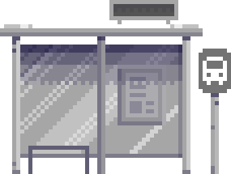

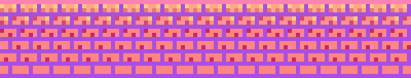
THANK YOU FOR PLAYING!
We hope you had a blast!!!

Slide 20
Team Member | Responsibility | Modules/Tasks
Sara | Game Initialization & Score Management | - Game Initialization (loading previous progress, setting up the game) - Score Management (tracking and updating score)
Dua | Building Generation & Movement System | - Building Generation (creating layout with floors and doors) - Movement System (handling player movement between floors)
Gulwarina | Random Events & Quiz/Challenges | - Random Events (treasure, traps, NPCs affecting score) - Quiz and Challenges (C++ knowledge challenges)
Aneeqa | Display Score, Save High Score & Game Continuation | - Display Score (visual score updates) - Save High Score (saving score to file/database) - Game Continuation (deciding whether to continue or exit)

